Slide 1
Discover Interact
And why YOU should consider joining

Slide 2
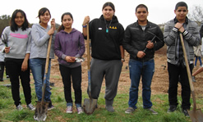
Making good things happen
INTERACT is:
An international organization of service & social clubs for youth ages 12-18 sponsored by Rotary.
Our INTERACT name is a combination of “INTERNATIONAL” plus “ACTION.”
We combine our ideas and strengths to make good things happen in our own school and community — and in communities around the world.

Slide 3
Making good things happen
INTERACT provides:
An opportunity to develop leadership skills as you serve in various capacities with your Interact club
An opportunity to be a delegate to the incredible Rotary Youth Leadership Awards conference
An opportunity to serve at the Interact District
Leadership level as a District Governor, Assistant Governor or Chief Assistant Governor over 45 clubs

Slide 4
Making good things happen
INTERACT provides:
An opportunity to gain service hours and experience you will need to qualify for scholarships.
An opportunity to accomplish more good by working with others than you could ever make happen on your own.

Slide 5
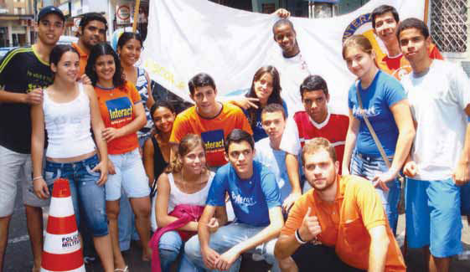
Making good things happen
INTERACT connects you with:
Other youth in your school who want to unite for fun and service.
Other youth in Arizona who are also members of Interact clubs in their schools.
Approximately 429,203 other youth in 18,661 Interact clubs around the world.

Slide 6
Making good things happen
INTERACT enables you to:
Make a life-long connection with the oldest, largest, most respected and most powerful service organization in the world — Rotary International.
Become eligible for scholarships, international exchanges and international graduate studies.
Meet and learn from some of the top business & professional leaders in your community.

Slide 7
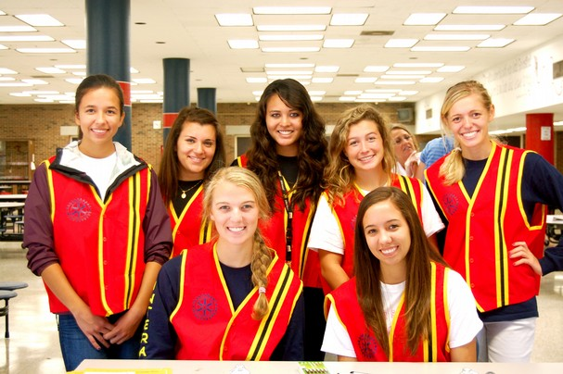
Making good things happen
We are an integral part of:
Rotary Clubs:
1,228,076 members
35,221 clubs in over 200 countries & territories
Interact Clubs:
429,203 members
18,661 clubs

Slide 8
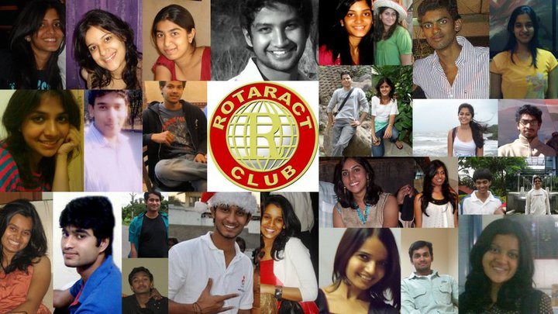
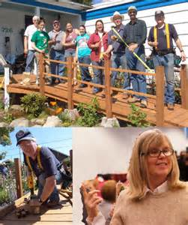
Making good things happen
We are an integral part of:
Rotaract Clubs:
194,028 members
8,436 clubs — for ages 18-30
Rotary Community Corps:
197,869 members
8,603 clubs
Together We Are ROTARY

Slide 9
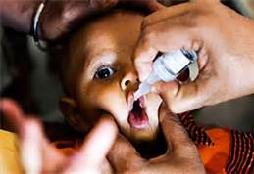
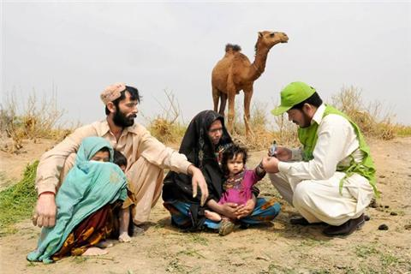
Making good things happen
And we are “this close” to:
Total world-wide eradication of the crippling and often fatal disease of Polio.
Only three endemic countries remain:
Afghanistan
Pakistan
Nigeria
We are helping finish what Rotary began in 1985 when 1,000 children a day were being crippled by this terrible disease.

Slide 10
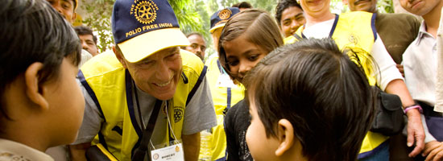
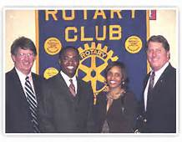
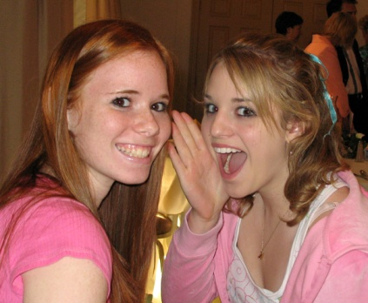
Making good things happen
INTERACT challenges you to:
Place SERVICE above SELF.
Follow the example of Rotarians who pledge themselves to high ethical standards in their businesses and professions.
To be the best you can be.

Slide 11
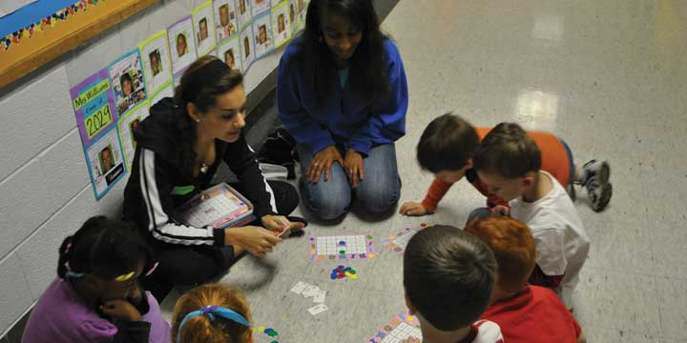
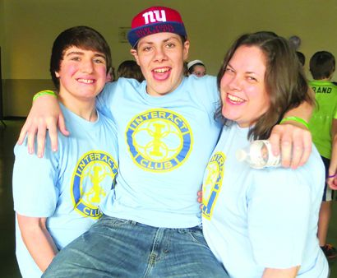
Making good things happen
INTERACT — what do you think?
Does this sound like YOUR kind of club?
Are you ready to begin making good things happen by being a part of this incredible world-wide organization?
Join INTERACT today!

