Slide 1
“Do you mean to tell me it is actually possible to Make Money by Donating Money for our Interact Club?”

Slide 2
Absolutely TRUE!
Here is how it works:
Most of you have to pay taxes to Uncle Sam and to Arizona on your income, and you have money withheld from your wages to pay those taxes.
Due to the Arizona tax credits system, though, YOU HAVE A CHOICE about where you want your Arizona tax money to go — to the State, or to invest it in our Interact Club to help us with the cost of our programs and service projects.

Slide 3
Here’s how it works . . .
As an individual you are allowed to donate up to $200 per year, and you can donate up to $400 per year as a couple to our school for our Interact Club.
And that donation will cost you NOTHING, because you will get it all back as an Arizona State Tax Refund, if you owe at least that much in tax on your income.

Slide 4
So how do I MAKE Money by donating for Interact?
Remember: You are paying both federal and state income tax.
If you itemize deductions on your federal tax return, you are able to claim that $200 or $400 donation to our school for Interact as a deductible charitable contribution on Schedule A of your federal tax return.

Slide 5
So how do I MAKE Money by donating for Interact?
So if you are in the 25% tax bracket, your $400 donation just saved you $100 on your federal income taxes.
In addition to getting your entire $400 back as a State Tax Refund, you pick up an extra $100 as a Federal Tax Refund — and it is all perfectly legal.

Slide 6
Making Money by donating for our Interact Club . . .
As I tell my tax clients, “This is really a ‘no-brainer’!”
If you can legally make money by giving money away, why would anyone not want to do that?

Slide 7
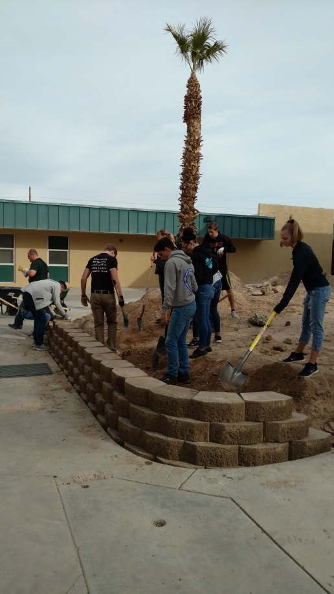
Making Money by donating for our Interact Club . . .
So who can do this?
Anyone who has to pay taxes — your family, your friends, your co-workers and your neighbors
But when does your donation have to be made, in order to make this work?

Slide 8
Making Money by donating for our Interact Club . . .
Federal and State tax laws are different
To get the State Tax Credit, you can make your donation any time during the tax year — and up to April 15 the next year
But Federal tax law only allows deduction of a charitable contribution for the year in which it was actually made

Slide 9
Making Money by donating for our Interact Club . . .
Please consider helping yourself by helping our Interact Club with your donation this year.
And also please help us to spread the word to others — you do have a choice about where your Arizona tax money goes.
Invest in Interact — and help us make a difference!

Slide 10
Thank You!
Your Interact Club
Committed to
Putting Service Above Self

