Slide 1




Schistosomiasis
schis·to·so·mi·a·sis

Slide 2





What is Schistosomiasis?
A parasitic disease that can enter the body and infect the brains and other organs of individuals, causing motor impairment, learning disabilities, and often even death
In tropical areas caused by the parasite, Cercariae, which is carried by freshwater snails
When the snails lay eggs in the water, the parasite detaches to swim looking for human or animals to infect. The parasite is a strong swimmer, it can swim up a urine stream or enter humans through skin pores.

Slide 3



Prevalence
200 million people are infected with Schistosomiasis yearly
80 million of these lives are children
There are 200,000 deaths every year.

Slide 4
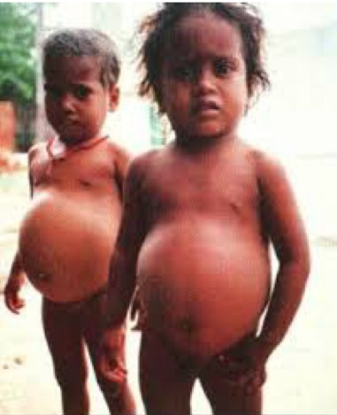

Slide 5
Found in all the highlighted areas below, however Schistosomiasis is most prevalent in 6 countries in Africa: Tanzania, Senegal, Cameroon, Uganda, Kenya, and Rwanda.

Slide 6

Importance to Rotary
Children infected become anemic, get malnutrition, develop learning disabilities, become resistant to the polio vaccine, and many die from it every year.
Schistosomiasis makes the polio vaccine ineffective!
This prevents Rotary’s goal to eradicate polio, so the fight against Schistosomiasis is necessary to conquer Polio

Slide 7


THE ROTARY SANITATION FOCUS
The fight against Schistosomiasis also supports Rotary’s focus on promoting water safety and sanitation Schistosomiasis is most commonly contracted when mothers bathe their children in rivers,
or young children play in infected water
We want to save the lives of these small children, and to enable them to safely play in parasite-free water!

Slide 8
To eliminate Schistosomiasis will require
Treatment of those children who have become infected
Education of their families to understand how they and their children can avoid becoming re-infected by the parasites causing the disease
Treatment of the infected water sources to eliminate the parasites responsible for Schistosomiasis

Slide 9






Treatments
Praziquantel is a drug used in the treatment for schistosomiasis.
However until recently it has only been available in adult doses.
Due to a recent break-through, there is now a Pediatric dose that costs only $2.00 for a treatment of 5 pills

Slide 10

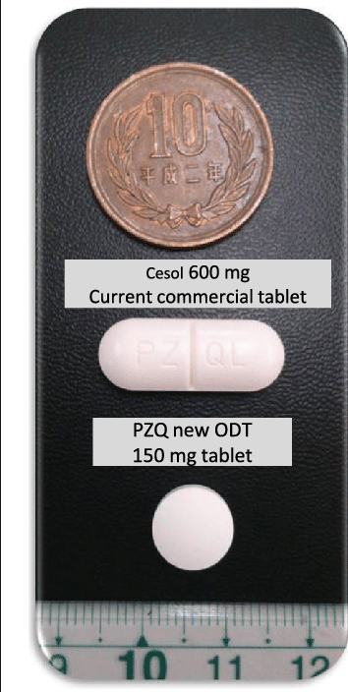

The adult treatment for Schistosomiasis is extremely bitter and 2cm big
size comparison of the adult and pediatric treatment
The new pediatric treatment is for small children 3 months to 6 years and is much smaller and less bitter
The new treatment will save their lives, but the treatment does not prevent re-infection

Slide 11


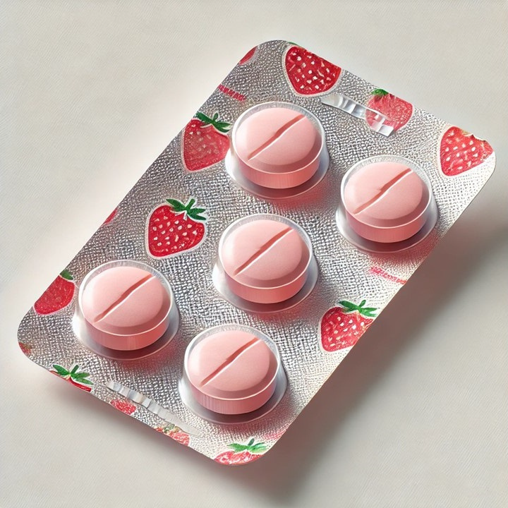

TWO DOLLARS TO SAVE A LIFE
With the new pediatric treatment
it only costs $2.00 to save a child from the life threatening disease that is Schistosomiasis.

Slide 12


Call to Interact
Schistosomiasis is a disease that greatly affects children. With this Interact has been called on
so “kids can help kids”. We hope to make the fight against Schistosomiasis the leading project for Interact Districts and clubs around the world.

Slide 13




The Interact Global Schisto Project
We are calling on all Interact Districts and clubs to start fundraisers in your schools and communities
We urge you to emphasize the idea that “it only costs
TWO DOLLARS to SAVE a life”
We are also calling on Interact to present this project to Rotary and Rotaract clubs, to help us spread awareness about Schistosomiasis

Slide 14
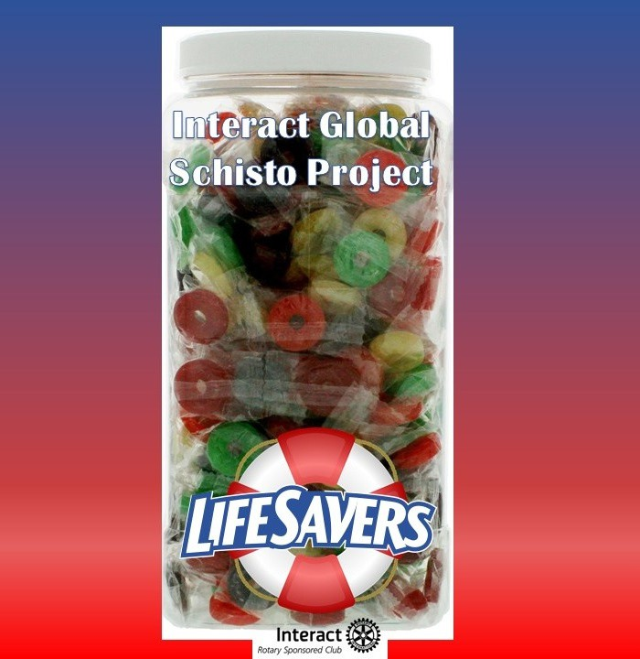
Lifesaver Trophy Jar
To show how each donation saves a life, we are encouraging every Interact club to use LifeSavers.
Put a LifeSaver candy in a jar every time somebody donates $2

Slide 15
First Country Interact is Targeting!
TANZANIA!!!

Slide 16
Resources to Donate
THIS IS A MODEL OF THE SCHISTOSOMIASIS PROJECT IN INTERACT DISTRICT 5495:
https://www.rotaryazinteract.org/_files/ugd/9b6a03_6a6b34fd084c47419f3f4dbc35c98531.pdf
DONATE TO:
Each Interact District will collect the funds from their clubs, then forward the combined funds, along with an accounting for how much was donated by each club, to:
Anthem Rotary Foundation
3655 Anthem Way A-109-PMB 107
Anthem, AZ 85086
FOR MORE INFORMATION CONTACT:
Jim Mulry
Global Health Schistosomiasis Coordinator Member of the Rotary Club of Anthem
Phone: (623) 295-7334
Email: Jimmulry54@outlook.com

Slide 17




